Slide 1
EE 8205 Basics of Engineering Electromagnetic
Name: Joseph Sospeter Salawa
Contacts: 0754556575
Email: yusufujss@gmail.com

Slide 2
Academic Qualification
Bachelor of Science in Telecommunications Engineering (UDSM 2011).
Masters of information Communication Science and Engineering (Electronics and Telecommunications Engineering option) (NMAIST 2016)
PhD in Electrical Engineering (Telecommunication option) (PAUSTI - On going)

Slide 3
Course Contents
Electrostatics:
Solution Lap lace’s equation for determining potential distribution in two dimensions boundaries, finite differences, graphical and experimental methods of field mapping for boundaries arbitrary shapes, Image methods.
Gauss’s theorem for electric flux density, calculations for isotropic and composite dielectric media and parallel conductor transmission line.
Magnetic aspect:
Magnetic forces, materials and Inductance, Force on a moving charge, force on a differential current element, force and torque on a closed circuit, the nature of magnetic materials, magnetization and permeability, magnetic materials, inductance and mutual inductancemagnetic potentials elements law and ampere’s circuital law for calculating H and B in fields produced by simple conductor configuration.
Maxwell’s equations including pointing theorem and boundary conditions; uniform place-wave propagation, transmission (lines – term modes, and pulse propagation, introduction to guided waves, introduction to radiation and scattering concepts

Slide 4
MODE OF DELIVERY
This module will be delivered by way of
Lectures
Tutorials
Assignments
Group project

Slide 5
Reference Books
William, H.H (1981), Engineering electromagnetic, Mc Graw – Hill,
Hayt, Jr. W.H &Kemmrly, J.E (1992), Engineering Circuit Analysis, Mc Graw- Hill, Inc
Bansal, R. (2006). Fundamentals of engineering electromagnetics. CRC press.
Boylestad, R. L. (2013). Introductory Circuit Analysis: Pearson New International Edition. Pearson.
Harrington, R. F. (2003). Introduction to electromagnetic engineering. Courier Corporation.

Slide 6
Time Table
DAY | TIME | VENUE
TUESDAY | 9:55 – 12:10 | LBH 6

Slide 7
Introduction
Electromagnetics is the study of the effect of charges at rest and charges in motion.
Some special cases of electromagnetics:
Electrostatics:charges at rest
Magnetostatics:charges in steady motion (DC)
Electromagnetic : charges in time-varying motion (AC)
Fundamental vector field quantities in electromagnetics:
Electric field intensity –E units = volts per meter (V/m )
Electric flux density (electric displacement) –D units = coulombs per square meter (C/m2)
Magnetic field intensity –H units = amps per meter (A/m)
Magnetic flux density-B units = teslas= webersper square meter (T = Wb/ m2)

Slide 8
In general, the physical quantities we shall be dealing with in EM are functions of space and time.
In order to describe the spatial variations of the quantities, we must be able to define all points uniquely in space in a suitable manner.
This requires using an appropriate coordinate system.
A point or vector can be represented in any curvilinear coordinate system, which may be orthogonal or nonorthogonal.
An orthogonal system is one in which the coordinates arc mutually perpendicular.

Slide 9
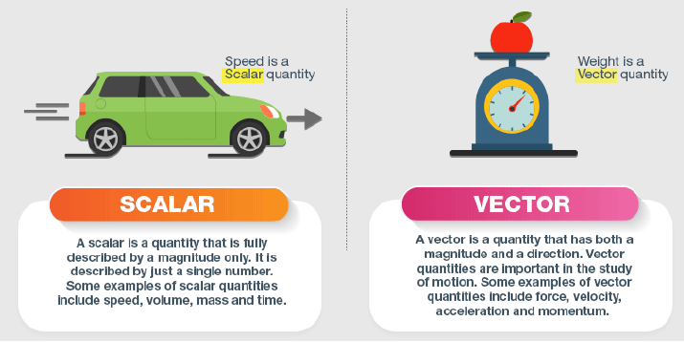
Scalar and Vector

Slide 10
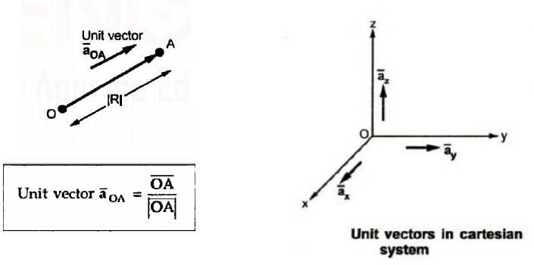
Unit Vector / Direction Vector
A unit vector is a vector with a magnitude of one unit.
Any vector can be expressed as a scalar multiple of its unit vector.

Slide 11
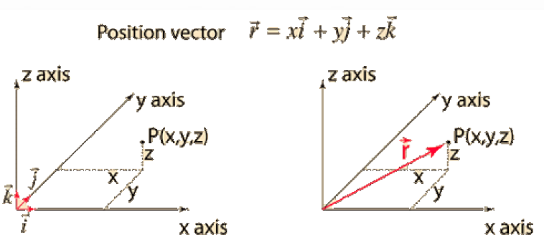
Position Vector

Slide 12
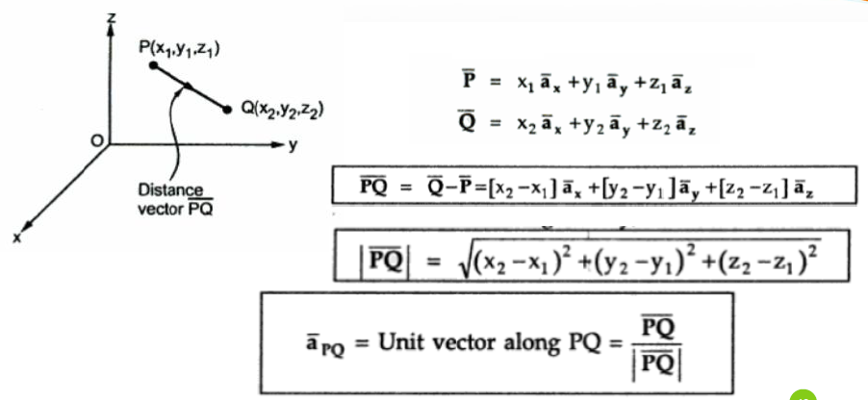
Distance Vector

Slide 13
Coordinate Systems
There are three types of Coordinate systems
Cartesian Coordinate system
Cylindrical coordinate system
Spherical coordinate system

Slide 14
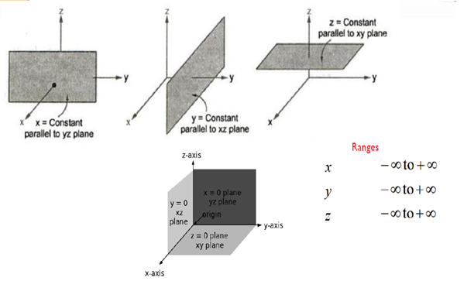
Cartesian System

Slide 15
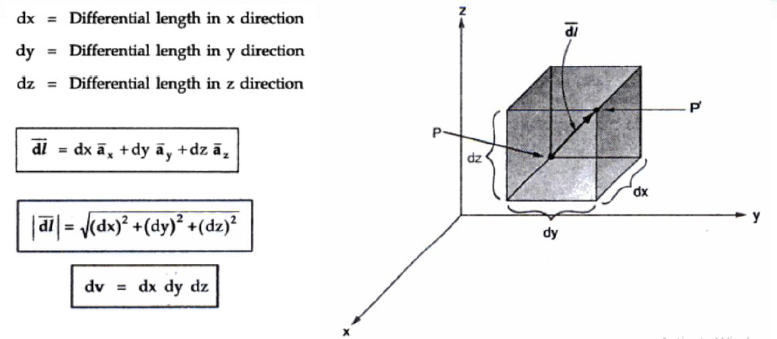

Slide 16
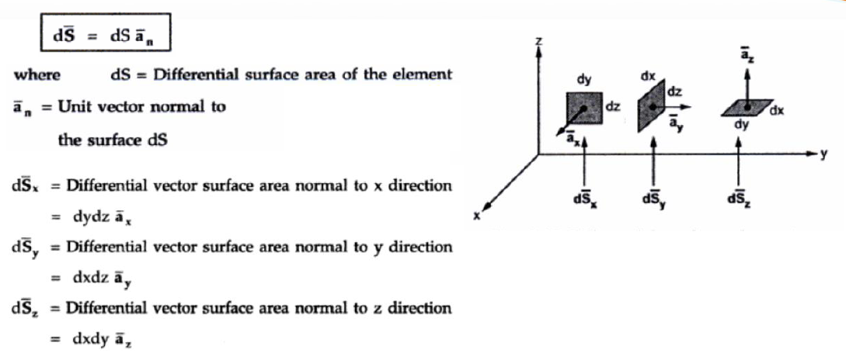

Slide 17
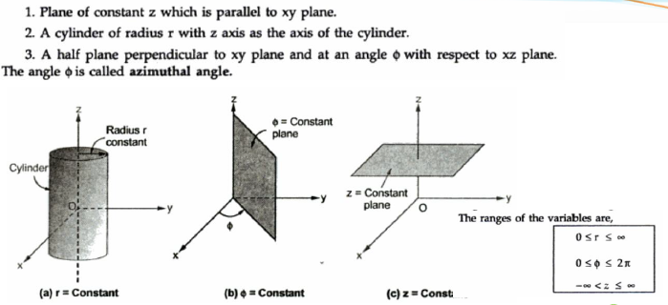
Cylindrical System

Slide 18
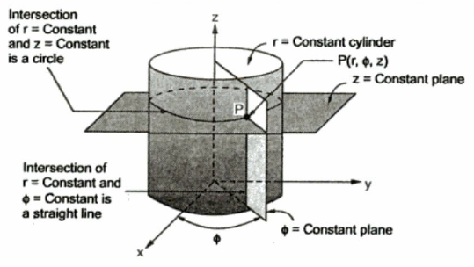
The circular cylindrical coordinate system is very convenient whenever we are dealing with problems having cylindrical symmetry.

Slide 19
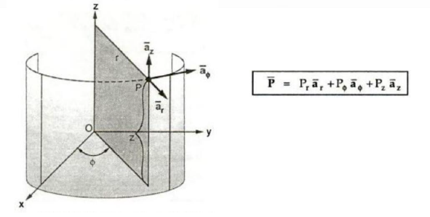

Slide 20
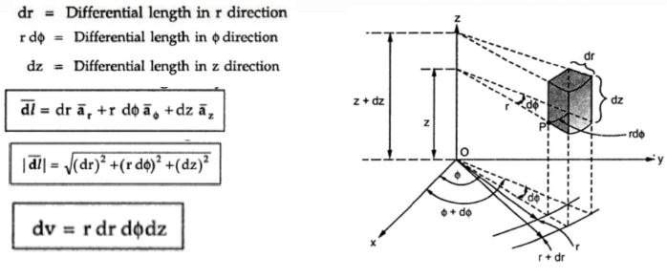

Slide 21
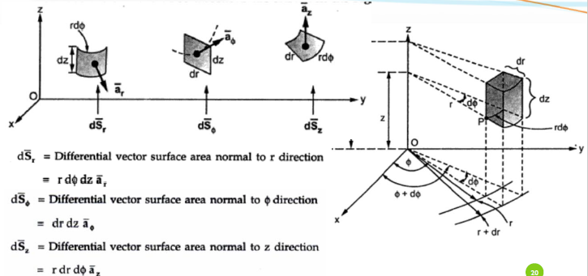

Slide 22
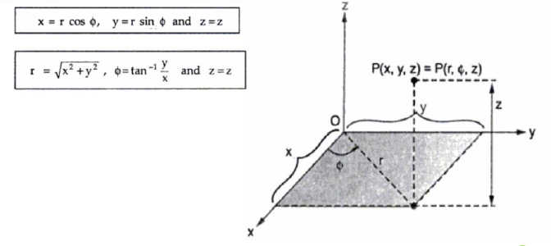
Relationship between cartesian and cylindrical systems

Slide 23

azimuthal angle, is measured from the x-axis in the xy-plane; and z is the same as in the Cartesian system.
The ranges of the variables are

Slide 24
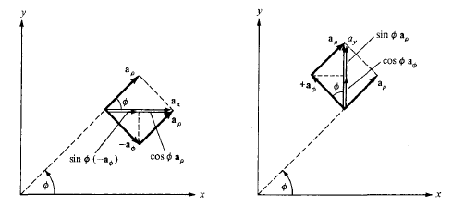


Unit vector transformation

Slide 25



In matrix form,

Slide 26
Example
Given point P(—2, 6, 3) and vector A = yax + (x + z)ay, express P and A in cylindrical coordinates. Evaluate A at P in the Cartesian and cylindrical systems.

Slide 27
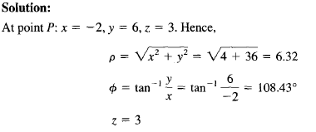





Slide 28
END OF PRESENTATION

